Slide 1
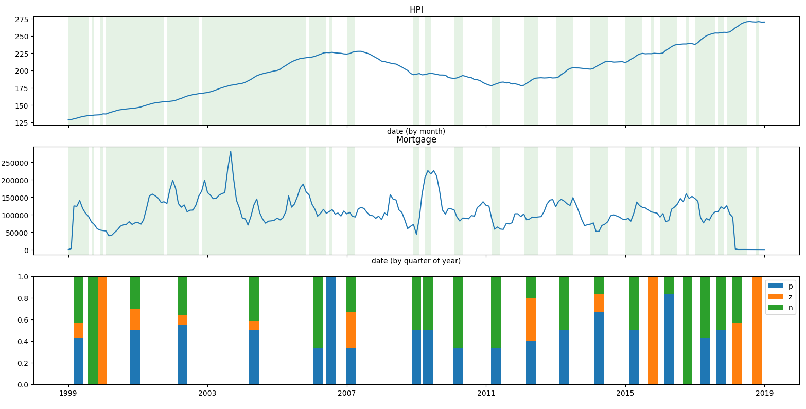
Frequency of characters in each interval
Translate the series in a sequence of characters based on the derivative, to find the HPI rising
The mortgage series is also translated into a sequence of characters, based on the derivative (p - rising, z-zero slope, n-decreasing)
Each window selected on the mortgage based on the rising of the HPI has a sequence of characters associated with the slope. For each window, the frequency of each character is made, giving an estimation of how much the signal changes over time, in that interval.

Slide 2
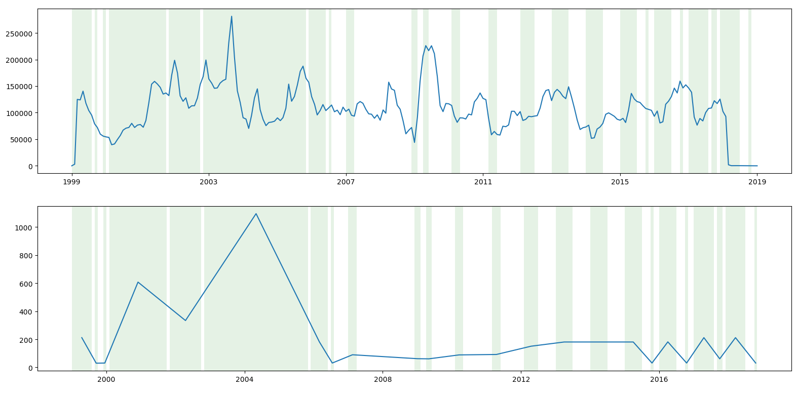
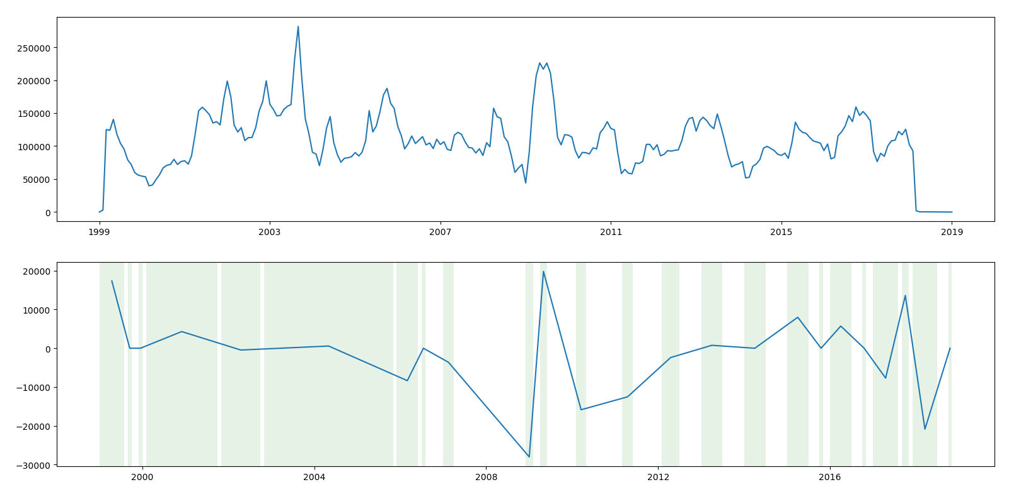
Interval width and (2) mean of slope
For each window, the size of the window (in days) is calculated
For each window, the mean slope is calculated

Slide 3
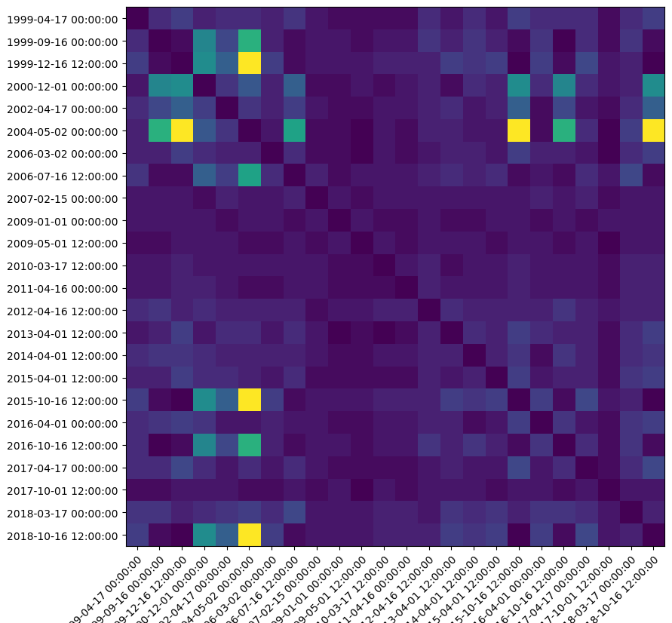
Levenshtein distance between strings
Confusion matrix of each window of characters in the mortgage counts series.
For each the Levenshtein distance is calculated.
The first square (1, 1) is the distance between interval 1 and 1, the second(2, 1) is the distance between interval 2 and interval 1, and so on.

Slide 4
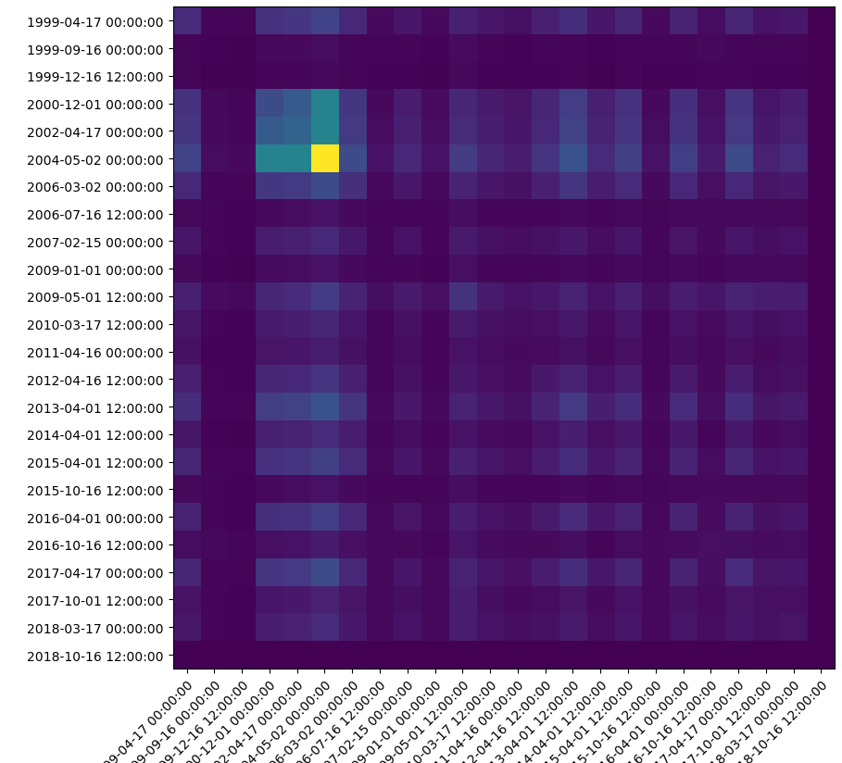
Convolution of mortgage intervals
Confusion matrix of each window of the numerical signal in the mortgage counts series.
For each the maximum of the convolution is calculated.
The first square (1, 1) is the maximum convolution between interval 1 and 1, the second(2, 1) is the maximum convolution between interval 2 and interval 1, and so on.

